Slide 1
Project Presentation
Problem Statement
Customer satisfaction has emerged as one of the most important factors that guarantee the success of online store; it has been posited as a key stimulant of purchase, repurchase intentions and customer loyalty. A comprehensive review of the literature, theories and models have been carried out to propose the models for customer activation and customer retention. Five major factors that contributed to the success of an e-commerce store have been identified as: service quality, system quality, information quality, trust and net benefit. The research furthermore investigated the factors that influence the online customers repeat purchase intention. The combination of both utilitarian value and hedonistic values are needed to affect the repeat purchase intention (loyalty) positively. The data is collected from the Indian online shoppers. Results indicate the e-retail success factors, which are very much critical for customer satisfaction.
Understanding
The dataset is of the e-commerce website in which several details related to the customers and the website is available .How to make the website more successful and the customer become the loyal to website means the customer make the purchases from the same website. For that five major factors that contributed to the success of an e-commerce store have been identified as: service quality, system quality, information quality, trust and net benefit. Now we have to analyse the data set.

Slide 2
EDA Steps
Data Cleaning:- The columns name changed since they are very long and unordered.
Checking for the Null Values.
Checking the Outliers using boxplot
Checking the correlation within the columns,
Checking the Multicollinearity using Variance Inflation factor.
Checking the Skewness and removed it with power transfor function.

Slide 3
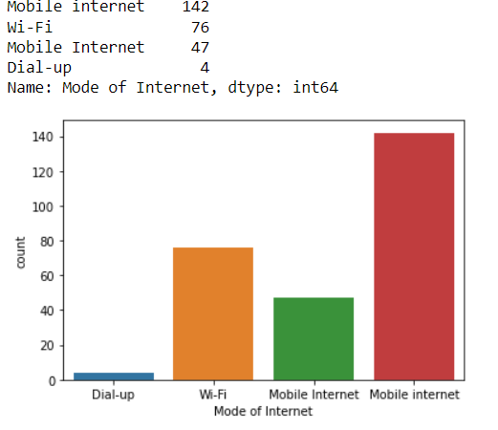
Visualization
Visualization is done with the help of the count plot which count the values of each category and display the graph.
for eg:- Mode of internet

Slide 4
Steps and assumptions used to complete the project
First we have read the data from the excel file.
After that we checked the shape and describe the dataset and analyze some information from that.
After that we have perform the EDA.
Visualization of the dataset.
Checking the outliers and skewness and removal of the skewness.
Checking the multicollinearity.

Slide 5
Analysis
We have analyzed that the data set is organized and no null values present In the data set . There are some outliers present in the columns but we did not remove them because those were th possible outcomes. While we check the correlation we found lots of correlation between the columns and after that we check for multicollinearity with the help of Variance inflation factor and we found that there is infinite correlation exists between the column.
While visualizing the data set we have seen that majority of the customers are above 20 age and most of them are the females. The customers are generally from the NCR region i.e. Delhi , Noida, Gr. Noida, and the majority of the customers are shopping since 4 years. The max. Customers purchases 10 times in the last 1 year. The customers generally do the online shopping through the Smartphones by using mobile internet. Max customers are using Google chrome for the online purchasing that means they are reaching the retail store through the search engine but not through the application. The customers exploring the website more than 15 minutes and make their payments through the debit/credit cards. But most of the times the customers abandon the cart because they found better offers on the same product. Coming to the rating part ajority of the customers strogly agree on the content that means the content is good and the information on the similar products is also good. The navigation through the website is good and the website processing is good, the interface is user friendly and the customers found the convenient mode of payments. The customers trust the websites and the website provides the guarantee of the privacy of the customer. The website gives the benefits and discounts to the customer and they strongly agree on that. The Website provides the good replacement and return policy and the customers enjoy easy shopping because of that. Majority of the customers will shop from amazon, flipkart, myntra, paytm, snapdeal. Most of the customers found amazon and flipkart web page layout easy. Most of the customers found good discounts on amazon and flipkart. The best website and application according to the customers is amazon as it has the appealing layout and the processing is very fast. The payment is fast on amazon and the speedy order delivery is also available on the amazon. In the last most of the customers found the best website is Amazon and also suggest amazon to their friends.

Slide 6
Conclusion
After analyzing the dataset I have found that most of the customers found amazon as the best application/website due to various reasons i.e. amazon is easy to use, its interface is user friendly, fast in process, has the best product information, shows relevant information on the similar product, delivery is fast, better discounts than other websites, has more trust on amazon than any other, payments are secure, good return and replacement policies and many more . I also analyze that most of the users use the website rather than the application for that there can be two reasons i.e. either they don’t know about the application of the retail e-stores or they don’t know how to use the application. Most of the customers are of above 20 age and they use smartphones for the online purchase.

